Slide 1
IP Connect UK
Meenakshi Bhatt

Slide 2
What is IP Connect UK?
IP Connect UK or IP Clear lets you connect different sites with different needs, locally and around the UK in the fastest, most efficient way to unlock your full business potential. It can simplify your communications over a single IP (MPLS) network with built-in security and scope to expand. It is also called UKMPLS as it runs over MPLS network which is connectionless.
IP Connect UK offers two network topologies in terms of VPN construction, any to any and hub/spoke.
IP Connect UK is also called as IP Clear or UKMPLS.
Note :OnOSS, the product is built as ‘IP Clear’.

Slide 3
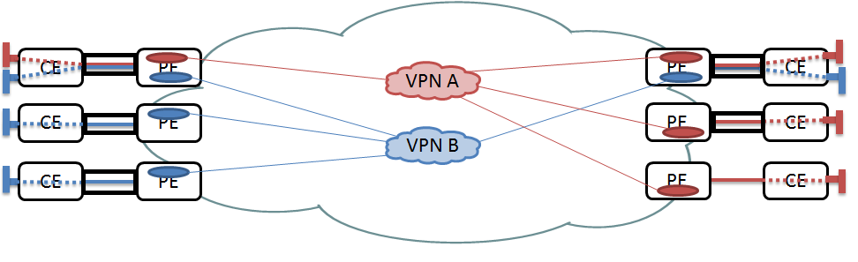
IP Connect UK Service Components
Access
Physical connection between customer site and BT network.
Connections
Port
Where access circuit terminates
PoP
BT footprints in UK i.e. BT exchange

Slide 4
Product Offering
IP Clear Wires Only
- Unbundled service
-No CPE ordered or managed by BT
-End customer billed for IP Clear service
IP Clear Managed
-Bundled Service
-CPE ordered AND managed by BT
- CS gets billed for IP Clear service which in turn bills customer.
-This is pick and choose service i.e. customer can have CE of their choice.
IP Converge
-Bundled Service
-CPE ordered and managed by BT.
-Bundled pricing for whole service i.e. no bills generated from IP Clear
-Pre-build product with no flexibility to change CPE.
Access Supplier
IP VPN
CE Router
Gateway
IP Clear Wires Only
IP Clear Managed
IP Converge

Slide 5
Product Offering
IP Clear Reach In
-BT MPLS manage end to end service provision and repair.
-This product is ordered when majority of sites are ROW .
IP Clear Reach Out
--IP Connect Managed will manage end to end service provision and repair.
-This product is ordered when majority of sites are UK .
IP VPN
BTMPLS
Access Supplier
Gateway
Interconnect Gateway
CE Router
IP Clear Reach Out
IP Clear Reach In

Slide 6
Physical Topology
CE
Customer Edge Router
PE
Provider Edge Router
ACCESS
(WAN)
P
Provider (Core) Router
CE
PE
PE
CE
P
P
CE
PE
P
PE
CE
P
P
CE
PE
PE
CE
CORE
WAN
LAN
CUSTOMER
PORT

Slide 7
Access Types
IP Clear Wires Only /Managed | IP Converge
IP Clear 10 M Flex / Local IP Clear 100M Flex/Local IP Clear GigE Flex/Local IP Clear 10Gig IP Clear 10M EFM IP Clear Superfast GEA IP Clear Port Only | IP Converge 10 M Flex / Local IP Converge 100M Flex/Local IP Converge 1000M Flex/Local IP Converge 10Gig IP Converge 10M EFM IP Converge Superfast GEA
IP Clear ADSL Connect IP Clear Superfast Connect IP Clear ADSL Connect Max | IP Converge ADSL Connect IP Converge Superfast Connect IP Converge ADSL Connect Max
IP Clear 2MB Flex IP Clear 2Mbit/s IP Clear 34Mbit/s Access IP Clear 155Mbit/s Access | IP Converge 2MB Flex IP Converge 2Mbit/s IP Converge 34Mbit/s Access IP Converge 155Mbit/s Access

Slide 8
Features Supported
Resilience
Shared Access
Multiple VPN’s
CoS
CPPA/CPPC
BGP
IPV4/IPV6
Multicast

Slide 9
Resilience
Standard
Single access circuit terminated on a single CE router at customer’s premises. There is no resilience and no automatic re-routing of traffic in the event of a failure within the access component.

Slide 10
Resilence contd…
Secure
This is provided using 2x CE Routers at the customer’s site and would require separate access connections back to 2x MPLS PE Routers (separate circuits / separate NTE) located within a single PoP site.
2 site orders raised (with same CSAC) each having a separate connection . However in 21C , two access orders are raised .

Slide 11
Resilence contd…
Secure+
It uses 2x CE Routers at the customers site, 2 Access Circuits terminating in separate Metro Nodes, Separate 7750 switches, and finally will connect to 2x MPLS PE Routers in separate PoP sites.
2 site orders raised (with different CSAC) each having a separate connection . In 21C also , two access orders are raised .

Slide 12
Shared Access
Shared Access allows a customer who owns an IP Connect UK access to give connectivity (via an additional VPN connection) to a completely different IP Connect UK customer. The “Main” customer is the customer who owns the access that is shared with another customer. The “Sharing” customer (or customers) are those who have VPN connections extended through another customer’s access.
Why we need shared access?
To support company mergers or provide extranet connectivity to different suppliers.
An application hosting customer .
Use for Network Management

Slide 14
Multiple VPN’s
Multiple VPN’S is a standard feature that allows the customer to segregate their traffic into separate VPN connections i.e. connectivity across a single access into more than one VPN owned by the customer
It enables the same physical infrastructure to provide logical separation to support for example different business units within the same company which do not wish to support direct connectivity between each other.

Slide 15
Class Of Service (CoS)
Class of Service (CoS) is a way of managing traffic in a network by grouping similar types of traffic (for example, e-mail, streaming video, voice, large document file transfer) together and treating each type as a class with its own level of service priority.
IP Connect UK supports 6 CoS model which supports 6 classes- EF, AF1, AF2, AF3, AF4 & DE
Class |  | Description
EF | Expedited Forwarding | optimised to support real time Voice over IP (VoIP) applications. Packets marked as EF are treated with priority throughout the core network and on access egress and are always served in preference to AF and DE traffic. The Class is particularly designed to deliver low end-to-end delay and jitter suitable for voice
AF | Assured Forwarding | A group of four classes (AF4, AF3, AF2 and AF1 with no prescribed order of performance). These classes would be used for premium, delay sensitive data applications..
DE | Default | This is a “best effort” class, which would be used non mission-critical, non-delay sensitive applications like email or web browsing.

Slide 16
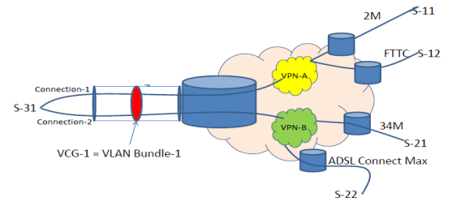
CPPA CoS Policy per Access
CPPA works on the basis that all traffic flowing through the access circuit will have the same CoS policy applied too it.
All connection in a VCG will have same CoS policy i.e AF,EF,DE
In terms of order on OSS, the circuit Id mapping is as follows:
Access
Order WILL have one access i.e. one site order.
VCG1
Order WILL have one VCG
Connection
Order WILL have one or more connections and all connection will belong to same VCG.

Slide 17
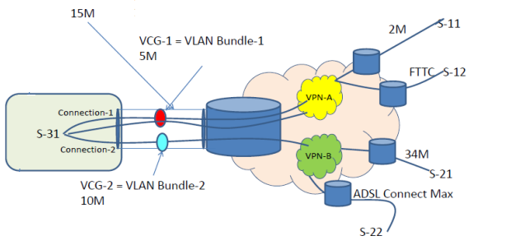
CPPC CoS Policy per Connection
CPPC allows customer to configure separate CoS policies for each VPN connection.
In terms of order on OSS, the circuit Id mapping is as follows:
Access
Order can have one access i.e. one site order.
VCG1
Order can have multiple VCG and there is one to one mapping between VCG and connection.
Connection
Order can have one or more connections and there is one to one mapping between VCG and connection.

Slide 18
BGP
Border Gateway Protocol (BGP) is a routing protocol used to transfer data and information between different gateways, the Internet or autonomous systems. IBGP is formed between Neighbours within the same AS whereas EBGP is formed between neighbours in different AS.
An Autonomous System (AS) is a collection of networks, or routers, administered as a group and sharing a common set of routing policies. AS numbers, the unique identifiers for these groups
CE
PE
PE
CE
RR
CE
PE
PE
CE
RR
CE
PE
PE
CE
iBGP
eBGP
eBGP

Slide 19
IPV4/IPV6
IP (short for Internet Protocol) specifies the technical format of packets and the addressing scheme for computers to communicate over a network
IPv4 uses a 32-bit address scheme allowing for a total of 2^32 addresses (just over 4 billion addresses).
IPv6 which provides not only a greater address range of 128 bits but other network benefits such as improved security. IPv6 offers 2¹²⁸ ≈ 3.4 x 10³⁸ or 340 trillion trillion trillion addresses.

Slide 20
(512Kbit/s LL Standard)
(HE 10M EFM
Standard)
V4
12K
10K
v6
V4
VPN1
V4+v6
V4
V6
VPN2
V4/V6
VPN3
12K
V6
(HE 100M Fiber
Standard)
VPN | Access | Connection
V4 or dual V4+V6) | IP Clear Fixed Rate 2M IP Clear 2M Flex IP Clear 21C HE Fibre & EFM | Address Type- IPV4, IPV6, IPV4+IPV6

